Slide 1
Exposing the Tooling API as a Mountable Filesystem
Jason Bury
dospromptman@gmail.com
https://www.linkedin.com/in/jasonbury
@dpm1661

Slide 2
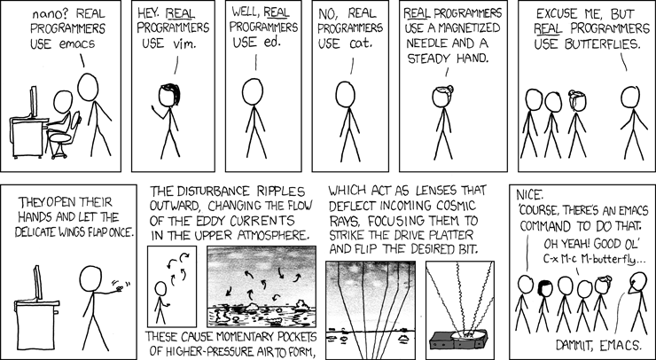
https://xkcd.com/378/ - “Real Programmers”
Notes:
Programmers can be "passionate" about their tools. Especially their editors.
You probably know someone, or maybe you ARE someone, that when writing code, has a moderate to.. let's say "strong" opinion about which editor they use.
This isn’t a necessarily bad thing. Some editors (like vi, for example) are just better than other editors. But really it is a personal choice. Everyone should be free to choose the editor that works best for THEM.
Unfortunately, there isn't too wide a selection of editors for Salesforce development, I think. At least not as wide a selection that you would have if you were working with a different platform.

Slide 3


Notes:
Myself, I prefer to use the best editor: which is vi.
But, there is a significant penalty if you use an editor that does not have some kind of built in integration with Salesforce, such that when you save your code it automatically deploys or something like that.
Back before the Tooling API existed, I did use vi to edit my Salesforce code. At the time, the alternative was the Eclipse based Force.com IDE.

Slide 4
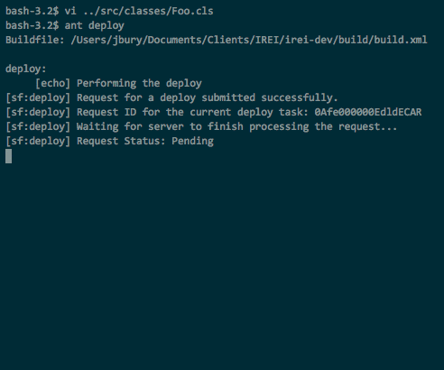
Notes:
Back then, this is what my workflow using vi to edit my code looked like.
This animation is in real time, but I won’t make you wait until the end. It takes over 3 minutes to deploy a one word change. This is not conducive to an iterative development cycle.
Salesforce created the Tooling API to help solve this problem. With the Tooling API you can perform a lightweight deployment of just a single file that happens in just seconds.

Slide 5
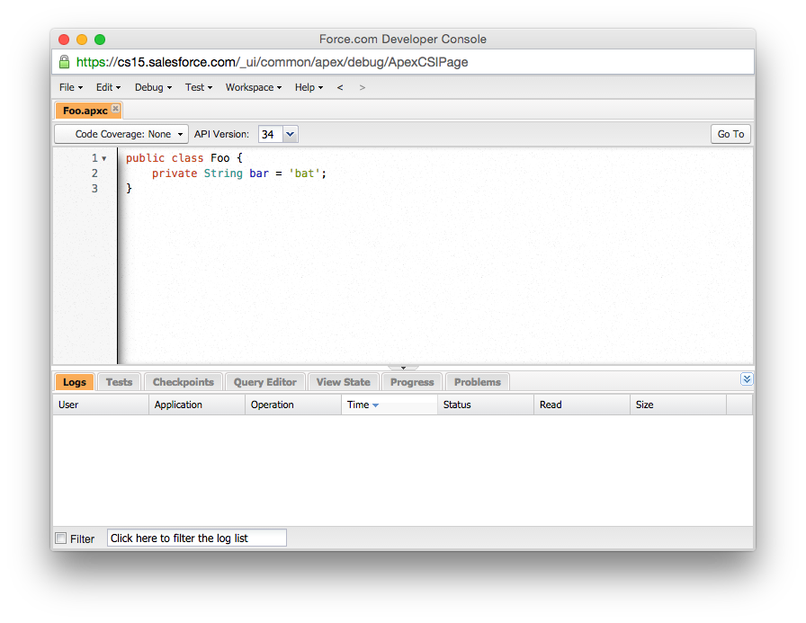
Notes:
The Salesforce Developer Console uses the Tooling API behind its editor to perform quick code checks and deploy changes on save. The Developer Console editor has come a long way since its initial release, and this is now the editor I use on a daily basis.
But… it’s not vi.

Slide 6



Notes:
There's also the MavensMate library, which is a wrapper around the Tooling API that you can use to add Salesforce integration to any extensible editor.
Currently, there are plugins for Sublime Text and Github's Atom editor.
There's also a command line utility that could serve as a replacement in my old ant based deployment workflow.
MavensMate is your best option for working with Salesforce code using the editor of your choice.

Slide 7
There is no MavensMate plugin for Vim
(yet)
Notes:
I’m not aware of a MavensMate integration for Vim, yet.
Somebody should write this.
If you were considering doing this, as a hint, I suggest looking at neovim (at neovim.io). It is a next generation vi editor specifically designed for extensibility.
Somebody please write this plugin!

Slide 8
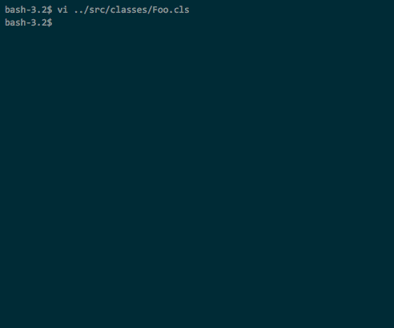
Notes:
There’s nothing like slow moving progress meters to inspire a programmer’s creativity.
I had a lot of time to think about the problem, and I started to have some crazy thoughts…

Slide 9
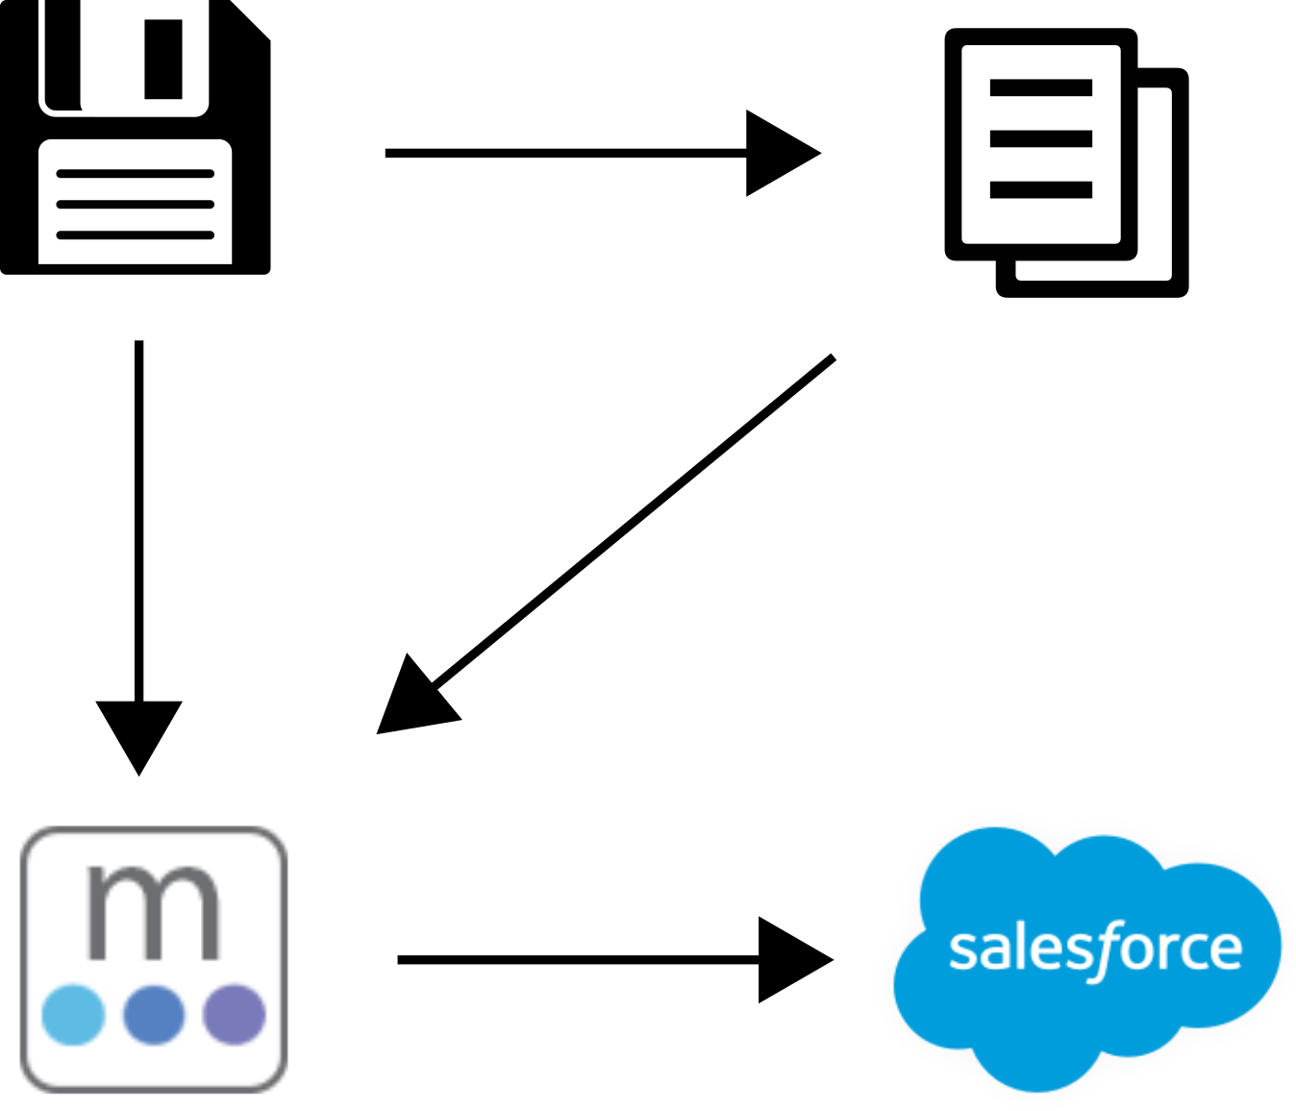
Notes:
Existing tools hook into the save action of the editor to trigger a code deployment.
The editor writes to the file, and then the *editor* calls for a deployment. The deployment tool reads from the file and writes it to Salesforce. Optionally, the deployment tool integrates with the editor’s reporting tools to indicate any errors that occurred during deployment.

Slide 10

Notes:
What if, instead, that deploy hook happened whenever the file was written to, without the editor even necessarily even being aware of this.
What if we had an operating system level file-like object that could be written to, and read from, and this would be translated into deploying and retrieving code from Salesforce.

Slide 11
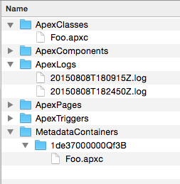
rm
cp
ln
grep
diff
tar
git?
Notes:
We could organize these file-like objects into directories.
We could use normal file-system commands to manipulate them.
We could use any editor we like to modify them.
And more?
I decided to see how far I could push this concept.
First, I considered using FUSE (Filesystem in Userspace). Unfortunately, I’m not a C programmer, and the bindings for python and node did not have great documentation. Also, FUSE is best supported in the GNU/Linux world, and other platforms only support it to varying degrees

Slide 12
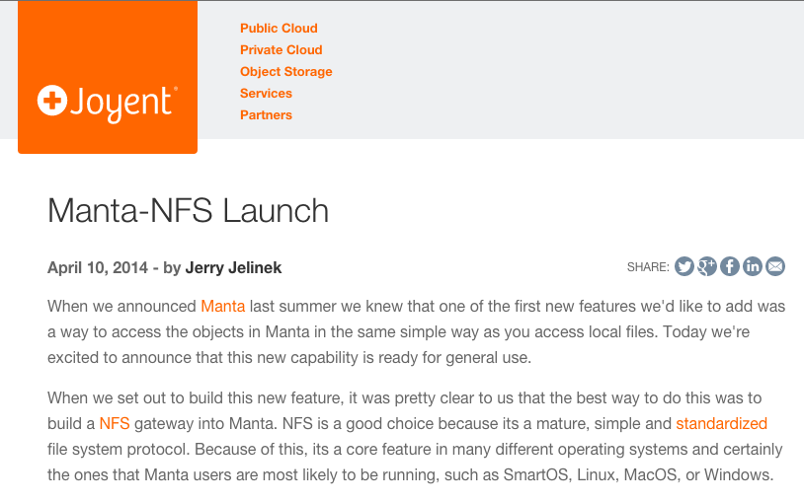
Notes:
Eventually, I found the node-nfs module, released by Joyent, last year, that implements the Network Filesystem Protocol to do pretty much *exactly* what I was envisioning, but for their Manta Storage Service. As Joyent points out in their launch announcement, NFS is supported natively in GNU/Linux, OS X, newer versions of Windows, and lots more.

Slide 13
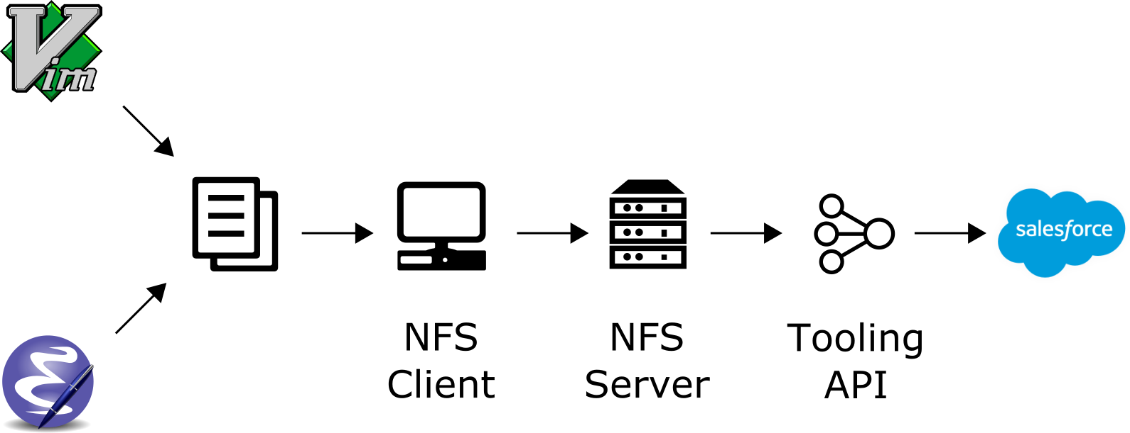
Notes:
What I ended up with is essentially a mash-up of the Tooling API and a custom NFS server.
Before I get into the specifics of how I glued these components together, let me talk about the Tooling API and the NFS protocol separately.

Slide 14
Tooling API Resources
ApexClass
ApexComponent
ApexPage
ApexTrigger
MetadataContainer
ApexClassMember
ApexComponentMember
ApexPageMember
ApexTriggerMember
ContainerAsyncRequest
Notes:
The Tooling API is a REST API that exposes the following resources:
ApexClass, ApexComponent, ApexPage, and ApexTrigger. These resources represent the metadata definitions of those code objects in an org. You can create these, delete these, etc.
The MetadataContainer resource represents a temporary workspace for storing metadata objects that are being worked on.
ApexClassMember, ApexComponentMember, ApexPageMember and the ApexTriggerMember resources represent working copies of metadata objects that live inside a MetadataContainer.
The ContainerAsyncRequest resource is used to initiate a deployment of objects from a MetadataContainer to the org. Creating an instance of one of these resources initiates the deployment.

Slide 15
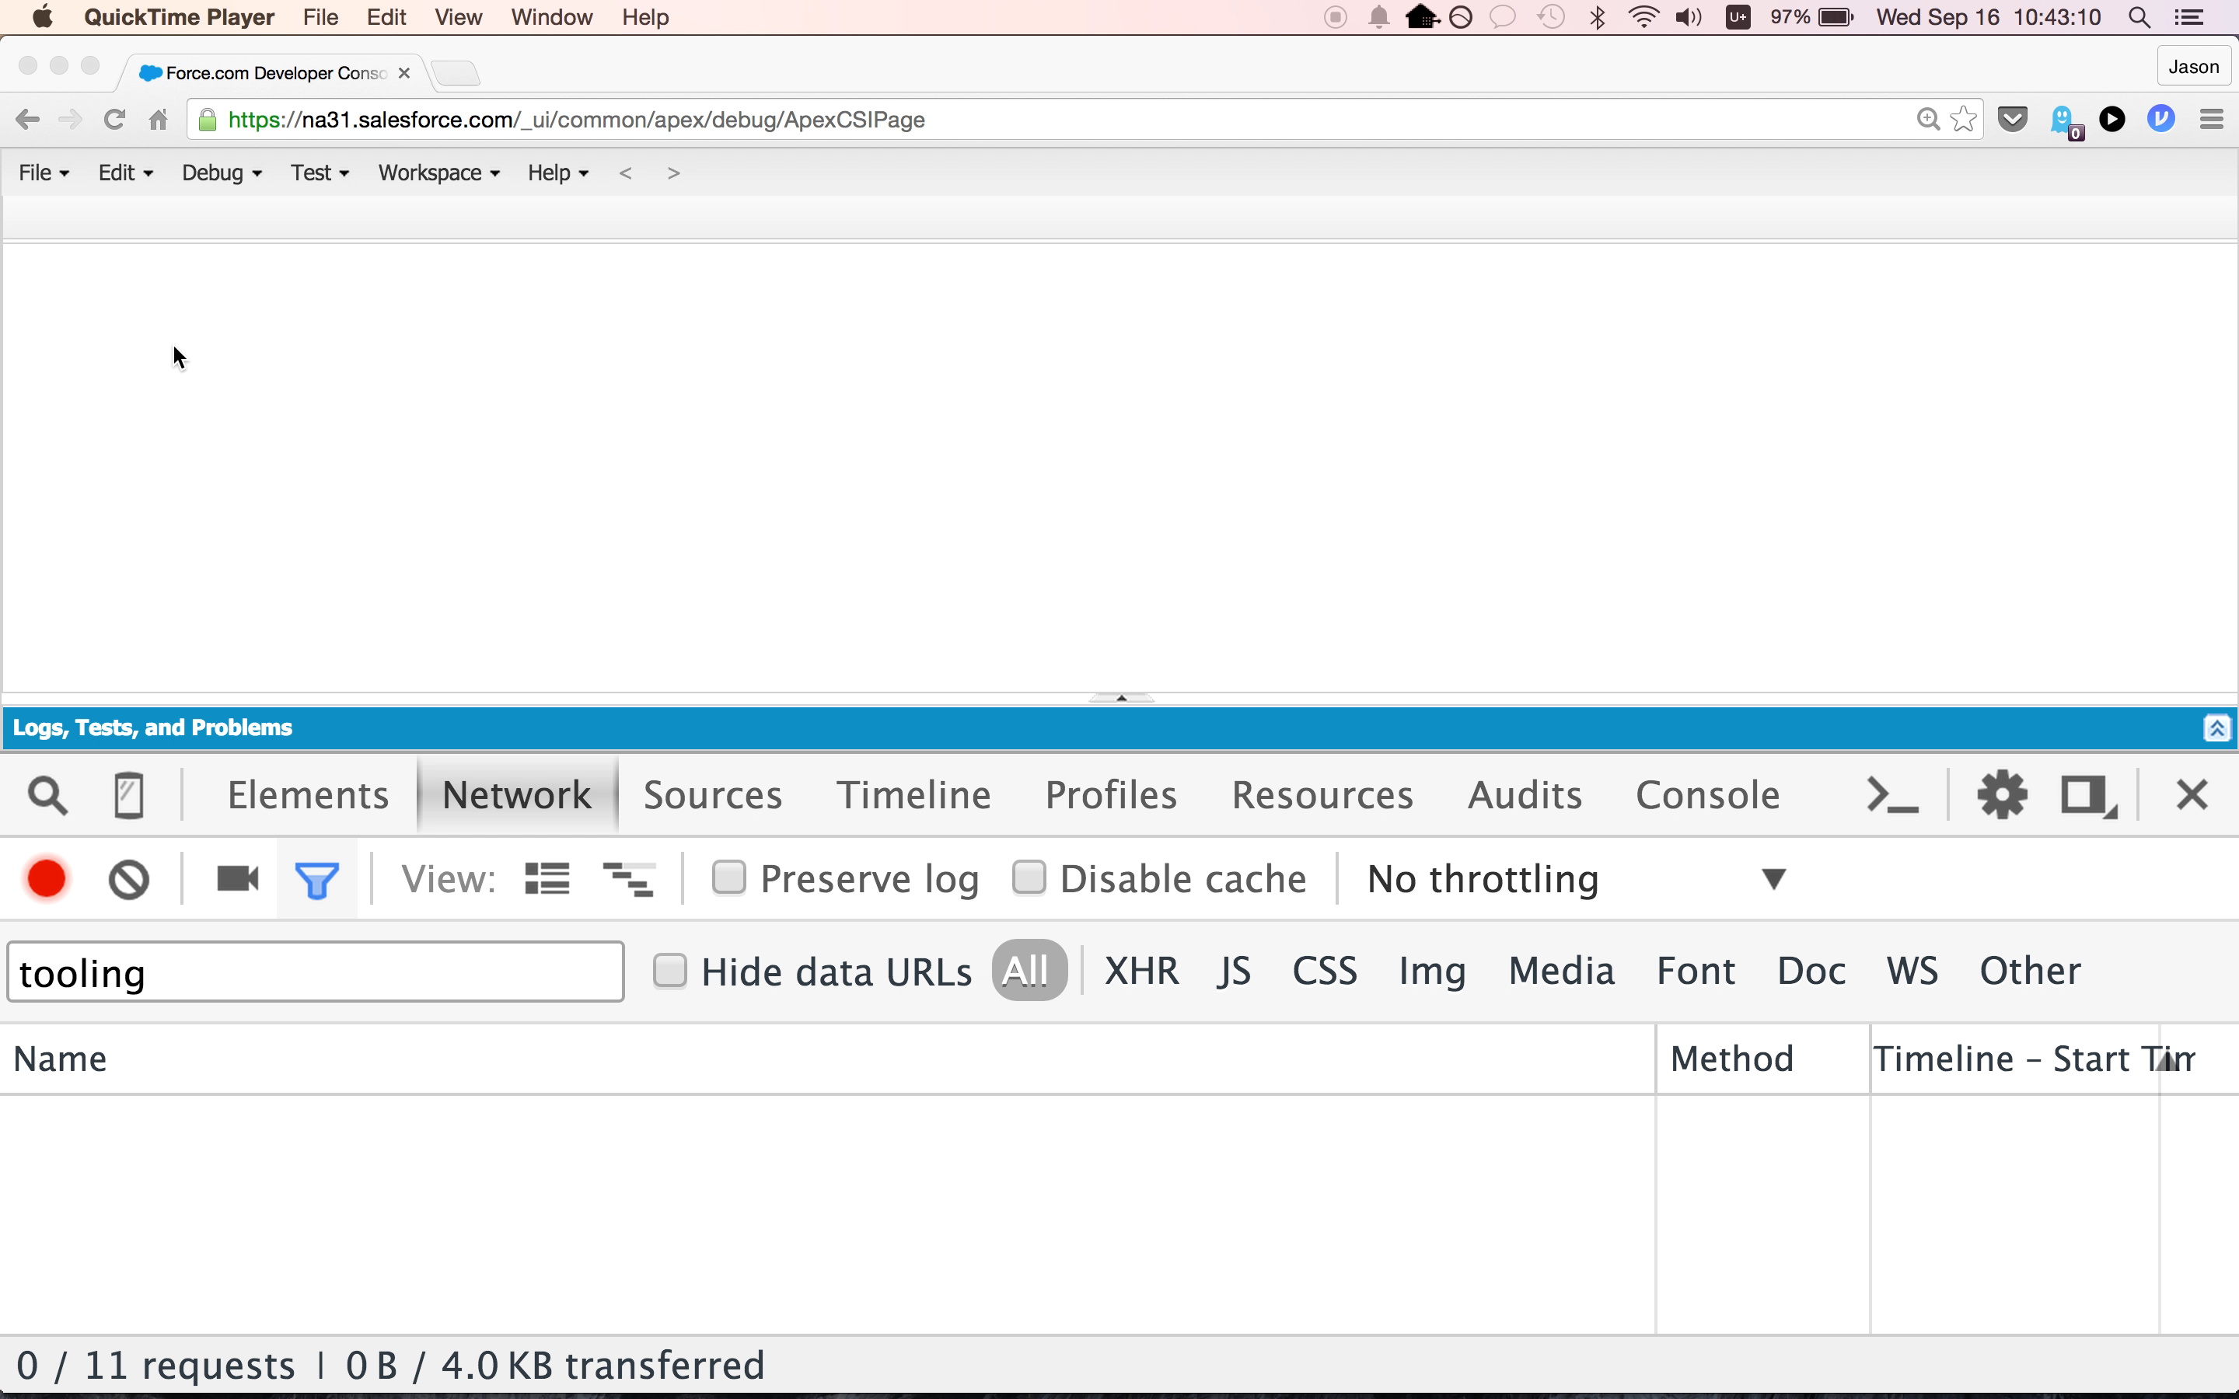

Slide 16
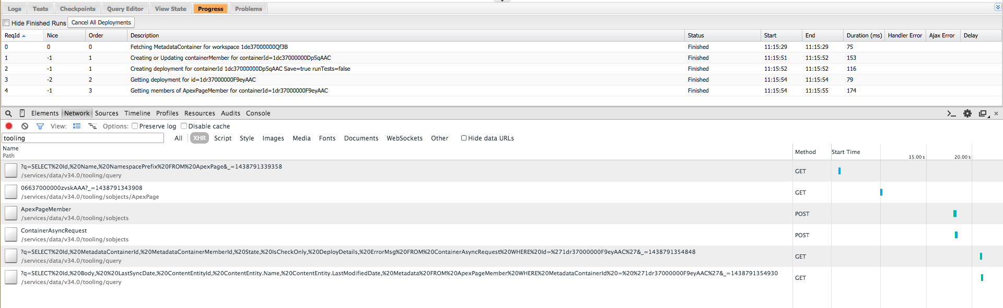
Notes:
To see how these objects are used together, let’s take a look at how the Developer Console handles a simple exhange.
Here, I opened the Developer Console, then chose ‘File’ and then ‘Open’. I double clicked on one of the pages in my org. You can see the query against the tooling API here that is done in order to give me a list of files to choose from. After I chose a file, another query fetches the content of the page in order to display in the editor.
Even though the concepts of creating or updating an object inside of a MetadataContainer and deploying it are separate, the Developer Console treats the ‘Save’ action as doing both. It creates an ApexPageMember object in the MetadataContainer that represents the ApexPage that I just edited and saved, and then immediately initiates a deployment of that content by creating a ContainerAsyncRequest object.
Eventually, the Developer Console queries the status of that ContainerAsyncRequest object and finds that the deployment succeeded.
Finally, the Developer Console queries the ApexPageMember that it created earlier, and fetches fresh details of this object. Note that the MetadataContainerId of the ApexPageMember has changed after the deployment. The member gets reparented to the ContainerAsyncResult, and is no longer a member of the MetadataContainer.

Slide 17
Notes:
There is a very short delay between when the ContainerAsyncRequest is created and when the Developer Console queries for the result.
The Developer Console developers do something that is very clever here, so I want to point it out.

Slide 18
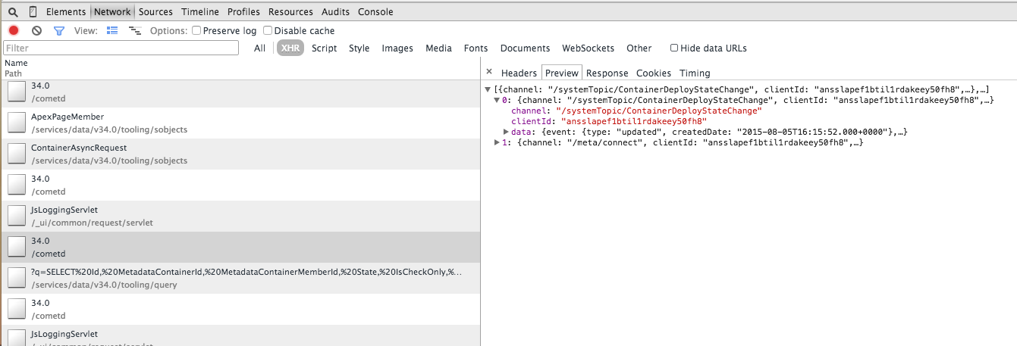
Notes:
The entire time that the Developer Console is running, it is connected to the Streaming API over a long-polling connection, and receives updates regularly from Salesforce.
In this case, a message is passed on the systemTopic ContainerDeployStateChange channel at pretty much the instant the deployment finishes. Listening for this message allows the Developer Console to waste no time, and it can request the updated details as soon as it knows there are changes to retrieve.
I think the Streaming API is very cool!

Slide 19
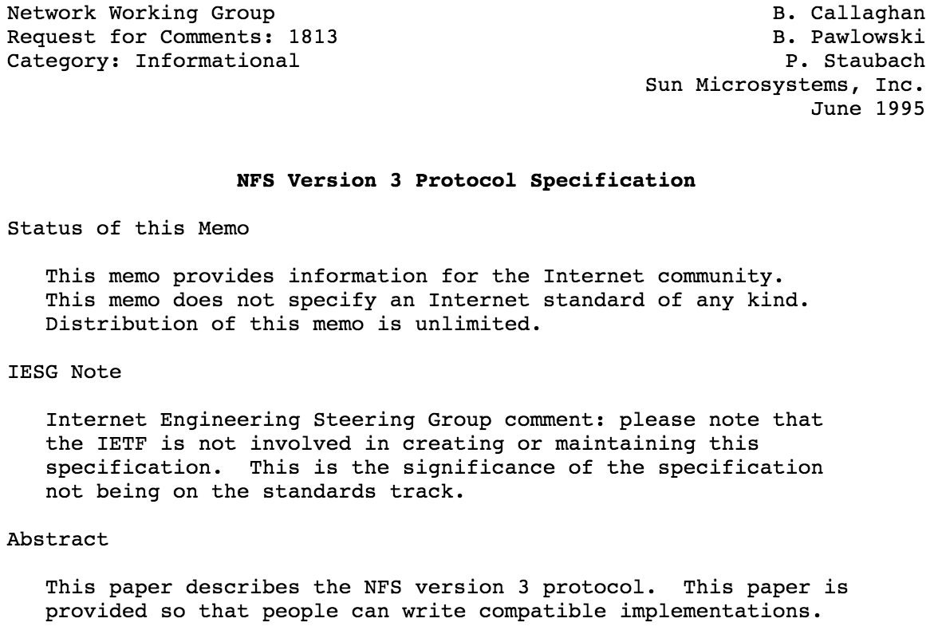

Notes:
So, we’ve seen that the Tooling API gives us the ability to get listings of code objects in the org, read their content, update their content, and all of this very quickly (on the order of a couple of seconds).
Now lets talk about NFS.
The Network Filesystem Protocol was developed by Sun Microsystems in the early 80s. It was built on top of their Open Network Computing Remote Procedure Call protocol, which provides for binary encoding of payloads in a platform agnostic way.

Slide 20
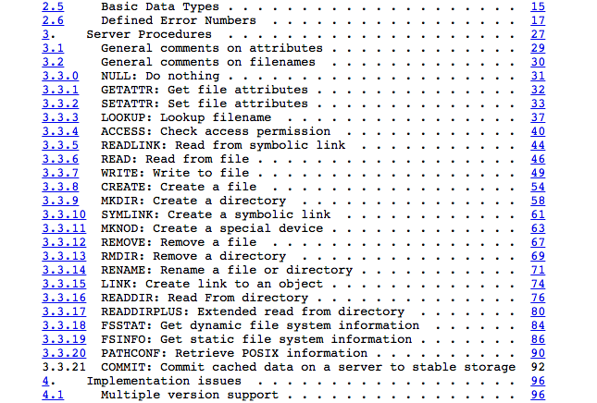
Notes:
NFS v3 is a widely supported version, and is defined in RFC 1813.
NFS defines a fairly compact set of remote procedures that a server can implement in order to provide access to files. NFS clients are responsible for binding these remote procedures to local filesystem calls, and the clients handle most of the hard work of translating between those system calls and the NFS RPC calls.
Some of the procedures that I’ll point out here are:
READDIR, which responds to a request to get a list of files for a given directory.
CREATE, which instructs the server to create a file in a given directory.
READ, which requests that the server return a number of bytes from a file, beginning at a given offset.
And WRITE, which instructs a server to write some data to a given file.
There about twenty or so procedures that cover the rest of the file system operations you might want to perform.
The Joyent module does all of the work of implementing the ONC RPC protocol, and routing those procedure calls to callback functions that we can define.

Slide 21
Tooling API | Network Filesystem RPC Method
SELECT Id, Name FROM ApexPage | READDIR
POST /tooling/sobjects/ApexPageMember/ | LINK
GET /tooling/sobjects/ApexPageMember/402…/ | READ
PATCH /tooling/sobjects/ApexPageMember/402… | WRITE(s) followed by COMMIT
POST /tooling/sobjects/ContainerAsyncRequest/

Slide 22
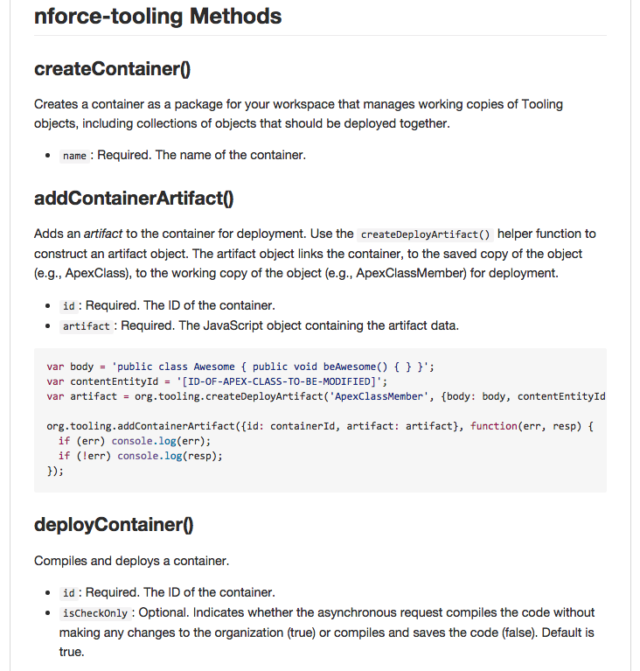
Notes:
To communicate with the Tooling API, I’m using the nforce module with the tooling plugin. These modules give pretty direct access to the individual tooling api endpoints, but also provide some nice Oauth handling, so I don’t have to worry about implementing this flow or handling token refreshes.
The specific actions of the Tooling API, such as creating MetadataContainers, createing Metdata members, and deploying the container are abstracted as function calls with accept callbacks or return a promise.

Slide 23
Notes:
The only thing left is to decide how to represent the objects exposed by the tooling API as a filesystem.
I decided that I wanted the mount point to represent the org. This directory contains directories for ApexClasses, ApexPages, ApexComponents, ApexTriggers, MetadataContainers, and ApexLogs.
Performing a directory listing in any of these directories causes the NFS client to invoke the READDIR procedure in our NFS server, which is translated to a tooling API call using the nforce tooling module to get a list of entities, and the directory listing is built and returned back.
The MetadataContainer directory is the only directory that is writeable, and the only operation is responds to is a MKDIR call, which creates a MetadataContainer instance via the Tooling API.
Inside of this created MetadataContainer directory, you can add members by creating a hard link to the desired entity in one of the other directories, which triggers a LINK NFS RPC call, and is translated to an nforce tooling module addContainerArtifact() call.

Slide 24
Future Improvements
Increase stability
Multiple org support
Explore configurations for using git with mounted files
StaticResource filesystem
Additional device-like files
DeployDetails results
Virtual ctags file
Other types of metadata exposed by the Tooling API
Notes:
First, I need to increase the stability of the software. As it is, using it in the wrong way can cause a kernel panic on OS X.
Next, I’d like to introduce support for mounting multiple orgs at the same time. This would allow you to copy metadata between orgs, perform a diff between files on different orgs, etc.
Current caching is minimal.
Can we use this to keep files under version control? What settings will git need to be able to work nicely with some read only directories.
Automatically decompress StaticResources and expose the contents as subdirectories, which would allow you to edit the contents directly.
A writeable pipe that allows for executing anonymous apex, a file that exposes the results from a DeployDetails result object for use with cmake or other error processing utilities, a virtual ‘ctags’ file using ‘completions’ endpoint and SymbolTable.
Other types of metadata like CustomField, etc.

Slide 25
Jason Bury
https://www.linkedin.com/in/jasonbury
dospromptman@gmail.com
@dpm1661 on Twitter

Slide 26


Over the past ten years, our team has helped shape our clients’ futures as well as served to simply make their business lives easier. Our role extends well beyond being experts in creating custom software – we consider ourselves your trusted business partner.
IMPLEMENTATION As process consultants, we assist adoption by focusing on how your team works day-to-day.
APEX & VISUALFORCE Our versatile, experienced team has a deep understanding of Salesforce’s native languages.
APPEXCHANGE DEVELOPMENT We develop AppExchange solutions and navigate the Salesforce security review process.
SYSTEMS INTEGRATION Salesforce can seamlessly integrate with your existing business applications and IT infrastructure.

Slide 27


Slide 29
Image Credits
"Real Programmers" by Randall Munroe - http://xkcd.com/378/ CC BY-NC 2.5
"Vim Logo" by Wikipedia user D0ktorz - GPL, via Wikimedia Commons
"Neovim Logo" by Jason Long - CC BY 3.0 unported
"GNU Emacs Icon" Copyright Free Software Foundation - Licensed under GPL
"MavensMate Favicon" and "MavensMate Logo" by Joe Ferraro - Licensed Under GPL
"Atom Icon" by Github - Licensed under MIT License
"Sublime Text Icon" created by Iconfactory Copyright SUBLIME HQ PTY LTD - Non-free used as “Fair Use”
"Sun Microsystems Logo" by Sun Microsystems - Non-free used as “Fair Use”
"API" from Noun Project, created by Emily van den Heever - CC BY 3.0 US
"Server" from Noun Project, created by Mister Pixel - CC BY 3.0 US
"Desktop" from Noun Project, created by Creative Stall - CC BY 3.0 US
"Document" from Noun Project, created by Samuel Q. Green - CC BY 3.0 US
"Floppy-disk" from Noun Project, created by Andreas Bjurenborg - CC BY 3.0 US

